Slide 1
AIM: Medieval Philosophy
Do Now:
Please answer the following question to the best of your ability:
How many angels can dance on the head of a pin?

Slide 2
Medieval World
From the fall of Rome (About 400 CE )
– the Renaissance (About 1400 CE )

Slide 3
Life in Middle Ages
When you get up I the morning, what is one thing you are absolutely sure of?

Slide 4
The Middle Ages In one sense this is conceived in terms of a relationship between knowledge revealed (Religion) and knowledge attained via human reasoning (Aristotle).
The Intellectual life of the Middle Ages is based in Scholasticism – a method of philosophy/learning that
attempted to reconcile the philosophy of the ancient classical philosophers like Aristotle with Christian theology.
Feudalism is a way of life. Everyone (Kings, Nobles, Peasants) owed obedience to a system in which society was structured around relationships derived from the holding of land in exchange for service or labor.
Overall this reconciling of faith and reason deals with what is reasonable to believe is beyond reason.
Works of ancient philosophers are translated from Greek to Arab and finally to Latin and brought to Europe with the meeting of cultures during the Crusades and through trade with the Arab world.
Arab and Jewish philosophers also had a great influence on the development of scholasticism.
The Christian (Catholic) Church was considered above such earthly concerns and is the center of learning in Medieval Europe.
To people in the Middle Ages, God was an undeniable fact. Everything in the universe was the way it was because God wanted it that way.

Slide 5
St. Augustine 354 – 430 CE
Originally a believer in Manichaeism: A religious belief that the world is is a constant struggle between a good, spiritual world of light, and an evil, material world of darkness.

Slide 6
According to Augustine, God is all powerful and all good, therefore he did not create evil. Evil is simple the lack of good, similar to a blind man who lacks sight or a thief who lacks honesty.

Slide 7
According to Augustine:
Humans are rational beings
In order to be rational humans must have free will
If humans have free will then they can choose between good and evil.

Slide 8
For Plato, the realm of eternal and perfect Forms is the only proper object of study, containing as it does the only true reality. St. Augustine saw Plato’s philosophy as profoundly congenial to Christianity in that Plato’s concept of two worlds, one eternally perfect and the other inherently imperfect, mirrors Christianity’s own postulation of two worlds, earthly and divine.

Slide 9
Thomas Aquinas 1225 - 1274
Aquinas’s greatest influence on intellectual history was his shifting attention from the works of Plato to those of Aristotle

Slide 10
Faith and reason are the two primary tools which are both necessary together for processing this data in order to obtain true knowledge of God. He believed that God reveals himself through nature, so that rational thinking and the study of nature is also the study of God (a blend of Aristotelian Greek philosophy with Christian doctrine).

Slide 11
In his work "Summa Theologica", Aquinas details five rational proofs for the existence of God,
The argument of the unmoved mover -everything that is moved is moved by a mover, therefore there is an unmoved mover from whom all motion proceeds, which is God.

Slide 12
The argument of the first cause - everything that is caused is caused by something else, therefore there must be an uncaused cause of all caused things, which is God.

Slide 13
The argument from contingency - there are contingent beings in the universe which may either exist or not exist and, as it is impossible for everything in the universe to be contingent (as something cannot come of nothing), so there must be a necessary being whose existence is not contingent on any other being, which is God.

Slide 14
The argument from degree - there are various degrees of perfection which may be found throughout the universe, so there must be a pinnacle of perfection from which lesser degrees of perfection derive, which is God.

Slide 15
The (teleological) argument from design - all natural bodies in the world (which are in themselves unintelligent) act towards ends (which is characteristic of intelligence), therefore there must be an intelligent being that guides all natural bodies towards their ends, which is God.

Slide 16
Teleology - a reason or explanation for something in the function of its end. For example, a teleological explanation of why forks have prongs is that this design helps humans eat certain foods; stabbing food to help humans eat is what forks are for. According to Aristotle the teleology of an acorn was an oak tree.

Slide 17
William of Ockham 1287 – 1347
Ockham's Razor

Slide 18
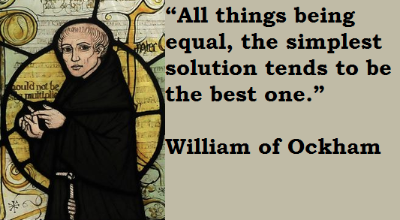
Ockham’s Razor

Slide 19
Thursday, 10/15 Test
Covering:
What is Philosophy?
Socratic Dialectic
Plato: Apology and Allegory of the Cave
Medieval Philosophy
Review using my Website:
BrentSocialStudies.EducatorPages.Com

